Slide 1

does your birthday make you better at sports?
ADDISON PRATT

Slide 2
Statistical analysis – chi-square test and the” MATTHEW effect”
The chi-square is a statistic used to determine if there is a relationship between categories. In this case, we are going to use the chi-square test to determine if there is a relationship between sports and their birthdays.
In statistics and sociology, there is a phenomenon known as the ”Matthew Effect”.
This is modeled after the scripture in Matthew 25:29 that says “For unto everyone that hath shall be given, and he shall have abundance. But from him that hath not shall be taken away even
that which he hath.” Basically, this means that those who are successful will be put in a position to receive more opportunities to become more successful. In other words, the rich will become richer and the poor will become poorer. There are various aspects of life where this phenomenon is evident. With the chi-square test, we will determine if the ”Matthew Effect” is evident in sports where an individual’s birthday will give an advantage to athletes and influence their success.

Slide 3
Compare to us population
This line chart shows the percentage each month contributes to the total percentage of births. It compares the US population’s monthly birthdays to the birthdays of Hockey players.
- We can see from this chart that the US population’s birth month is almost plateaued and almost have the same proportion. In the birth month of Hockey players, however, it is a different story. This is possibly because of the Matthew effect. Let’s investigate further.

Slide 4
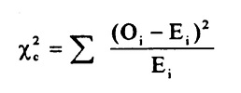
The Hypothesis
Statistical analysis – Chi square test
For this test, we will be using a level of significance of 0.05 which will result in a 95% confidence interval. I chose 0.05 because it is the most common in the statistical world.
First we determine the test statistic which is calculated by (the (observed count - expected count)^2/(expected count). The formula can be simplified like this:
From our calculations in this test, we gain a test statistic of 430.186. We can then determine the p-value of this test using the test statistic and the degrees of freedom. In this case, d.f is equal to 44.
H₀: The number of players in the sport is independent of the birth month
H_{a}: The number of players in the sport is not independent of the birth month

Slide 5
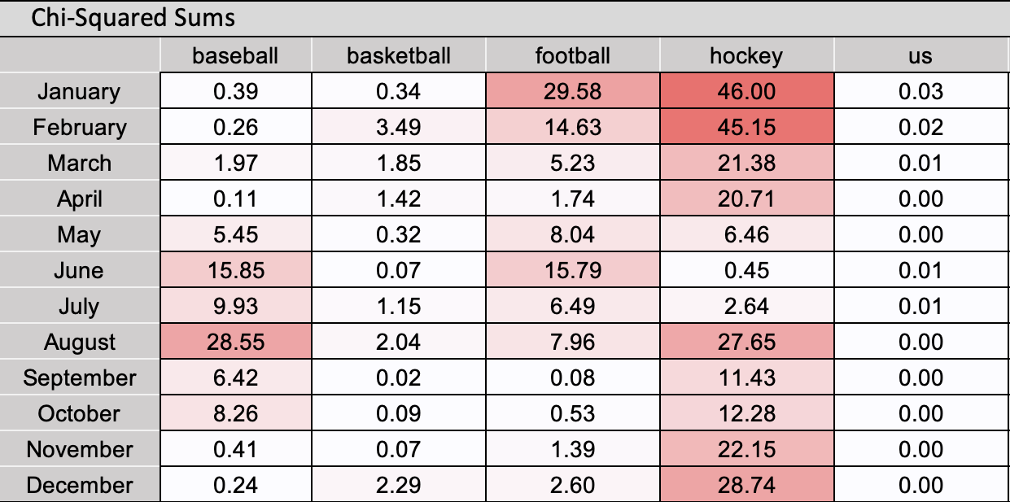
Chi – TeSt pt.2 Assessing the results
Here we have the charts created in excel from the sports data.
- The bottom chart shows the observed births in each sport per month.
-The top chart is a heat map showing the chi-squared sums. This shows some interesting results. The parts that are colored dark show the months with the most births. This is interesting because each month that is colored dark in each sport is right after the cutoff of each sport. For example, in baseball, the cutoff is July 31st, because of this the oldest players will be in august. The above chart shows that there are a lot successful baseball players in august. This same observation is evident in the other sports as well.
Numerical Summary: Observed Counts
 | baseball | basketball | football | hockey | us
January | 767 | 401 | 2,502 | 823 | 6,979,322
February | 686 | 399 | 2,269 | 772 | 6,511,697
March | 729 | 426 | 2,408 | 785 | 7,147,368
April | 727 | 359 | 2,141 | 753 | 6,850,733
May | 706 | 389 | 2,171 | 734 | 7,175,367
June | 655 | 392 | 2,100 | 646 | 7,122,586
July | 719 | 442 | 2,295 | 658 | 7,527,284
August | 972 | 396 | 2,312 | 570 | 7,624,626
September | 871 | 418 | 2,406 | 604 | 7,440,659
October | 864 | 413 | 2,310 | 588 | 7,293,822
November | 757 | 379 | 2,269 | 522 | 6,884,173
December | 755 | 369 | 2,378 | 528 | 7,155,101
Total | 9208 | 4783 | 27561 | 7983 | 85712738

Slide 6
Chi – TeSt pt.3 Assessing the results.
Hypothesis Test
H₀: Row variable is independent of the column variable.
H_{a}: Row variable is not independent of the column variable.
Test Statistic ( Pearson Chi-Square ) | d.f. | P-value
430.186 | 44 | 8.08E-65
- From the test statistic determined we achieve a p -value that is very small. It is so small that it is 8.08 x 10^-65.
- Because our level of significance is 0.05, in statistics if the p-value is low, then we reject the null hypothesis. In this test, since the p-value is lower than the level of significance we can reject the null hypothesis.
WHAT DOES THIS MEAN?
Since we reject the null hypothesis in this test, we have sufficient evidence to conclude that the number of players in a sport is dependent on the birth month. We have evidence to believe that the birth month does influence a player’s success in a sport.

Slide 7
Additional Evidence Found in Baseball

Slide 9
Explanation
The previous charts show the Matthew effect that is evident in baseball. In baseball, the cutoff date is July 31st. We see from the data that the month with the most amount of players in baseball is august. This is because they are the oldest and the Matthew effect is taking place. We see that the first quarter after the cutoff has the most players. The data is continuous and follows a downward trend as we go later in the year and the players become younger.

Slide 10
Conclusion
- From the data collected and the research we’ve done in this case study, I believe there is sufficient evidence to support that the Matthew Effect is found in sports. In sports such as hockey and baseball, it can be found more prevalent, however, it is not as obvious in sports like basketball and football ie. the chart on the right. From the research however, it can still have an influence.
- The fact that the Matthew effect is present in sports makes logical sense if we think about it. Those that are the oldest in their division are generally going to have physical advantages over the younger ones. An eleven-month age gap can make a huge difference in performance especially when the kids are going through puberty. As the older kids have an advantage, they will be seen and get to play more. This will lead to more opportunities to learn, grow, and increase in skill. This will have an impact over the years and will contribute to their success in sports. At the end of the day, a hard work ethic and talent can’t be excused as it is the main factor of success, however, evidence shows that your birthday can indeed make you better at sports.

